Slide 1

Web-development React-02
06
Prepared by: Abdalrahman Essam

Slide 2
TABLE OF CONTENTS
01
Why learning something new?
03
JavaScript XML
02
Framework/Library
04
VITE
05
React Hooks

Slide 3

01
What is Routing?
Linking pages

Slide 4
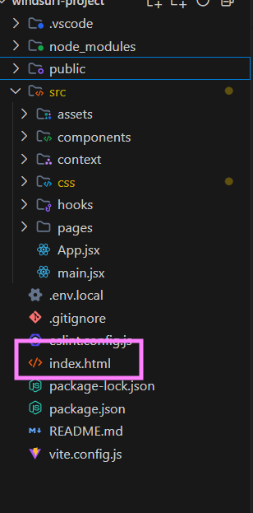
What is Routing?
In a traditional multi-page website, when you click a link, your browser sends a request to a server, and the server sends back a whole new HTML page. A Single Page Application (SPA), like the one you've built with React, works differently. It loads a single HTML page (index.html) and then uses JavaScript to dynamically change the content on that page as the user interacts with it.
Routing: in a React application is the process of keeping your application UI in sync with the URL. It allows you to navigate between different "pages" or views within your app without needing to reload the entire page from a server. This creates a faster, smoother user experience.

Slide 5
Implementing Routing with React Router
React doesn't come with a built-in router. The most popular library for handling routing in React is react-router-dom. Let's add it to your project.
Step 1: Install react-router-dom
First, you need to add the library to your project's dependencies. Open your terminal in the Movie App directory and run:

Slide 6
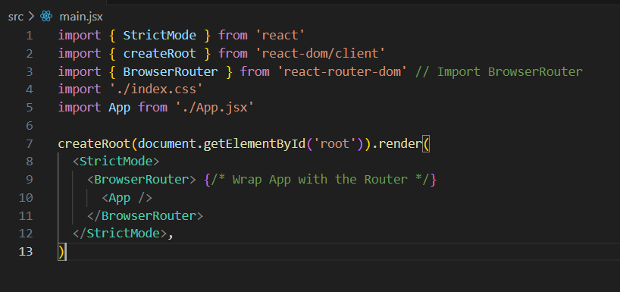
Implementing Routing with React Router
Step 2: Set Up the Router
We need to make the routing functionality available to our entire application. The best place to do this is in src/main.jsx by wrapping your <App /> component with <BrowserRouter>.

Slide 7
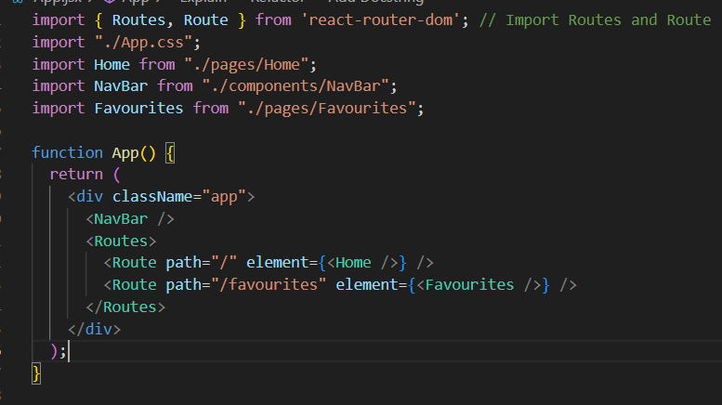
Implementing Routing with React Router
Step 3: Configure Your Routes
Next, let's update your main App component. Instead of using a useState hook to manage which page is visible, we'll define our routes. We will use the Routes and Route components to render the correct page component based on the URL path.

Slide 8
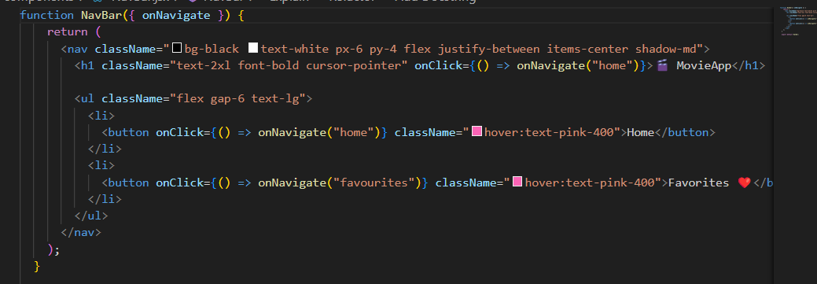
Implementing Routing with React Router
Updating the state outside the App.jsx?
Check the flaws of that implementation

Slide 9
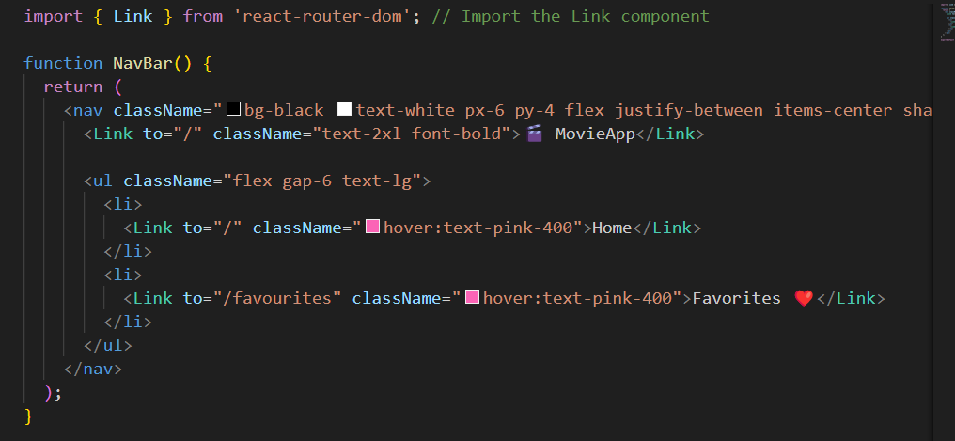
Implementing Routing with React Router
Simpler, more readable and NO state is being changed outside the parent!

Slide 10
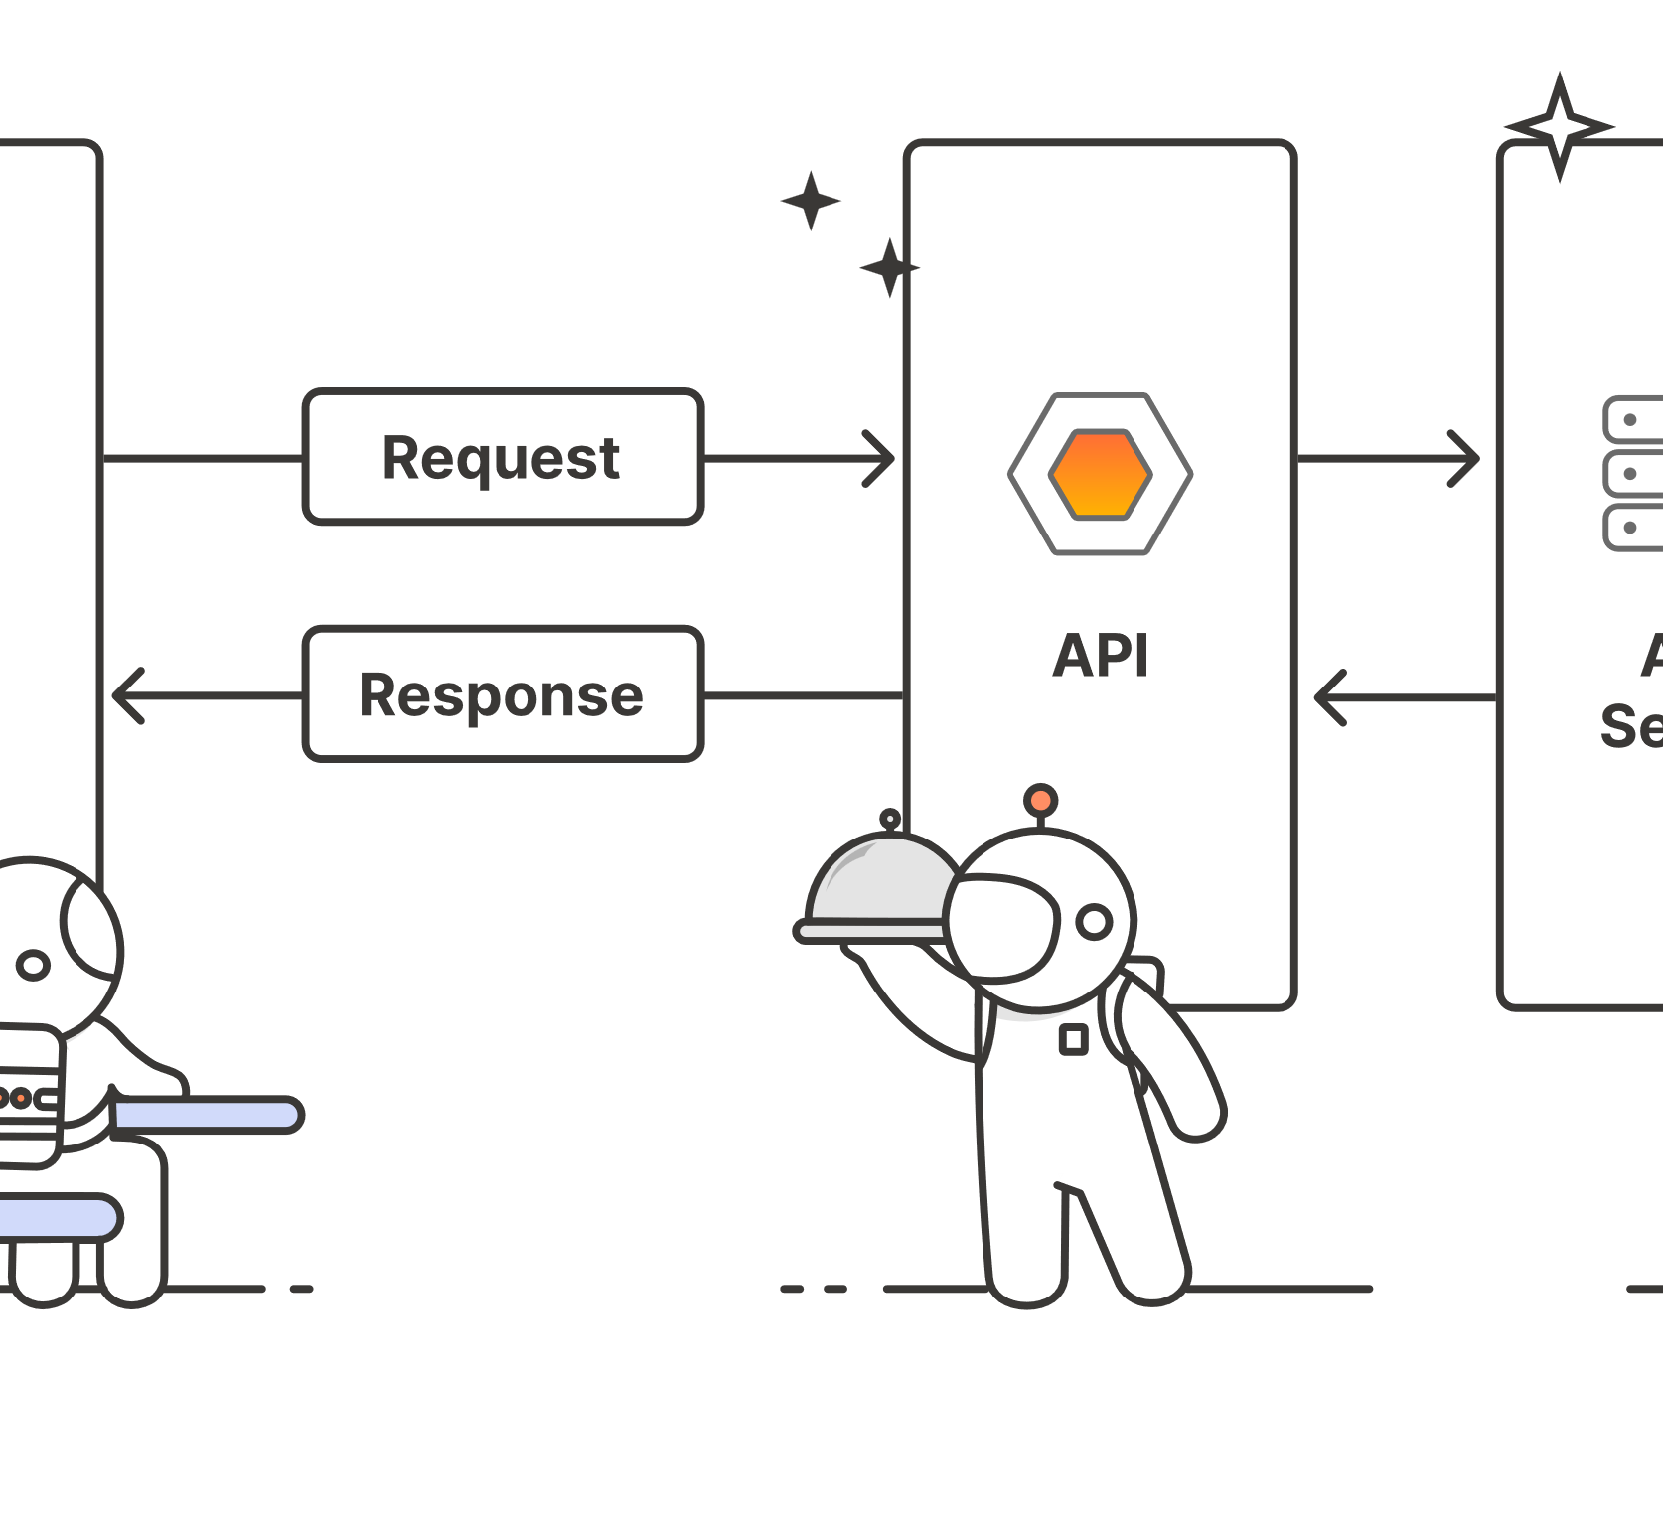
02
API?

Slide 11
What is an API?
An API, or Application Programming Interface, is a set of rules and tools that allows different software applications to communicate with each other.
n web development, APIs are commonly used to fetch data from a server. Your React application (the "diner") makes a request to a server (the "kitchen") via an API (the "waiter"), and the server sends back the requested data, usually in a format like JSON.

Slide 12
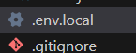
Let's Implement It: Fetching Movies from TMDB
We'll update your Home page to fetch a list of popular movies from TMDB instead of using the hardcoded array.
You'll use the useState hook to store the fetched data in your component's state, and the useEffect hook to fetch the data when the component loads.

Slide 13
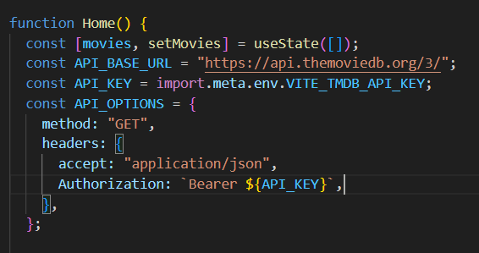
How to connect?
Same as before but now we start from empty array
The end-point
The options provided by the API

Slide 14
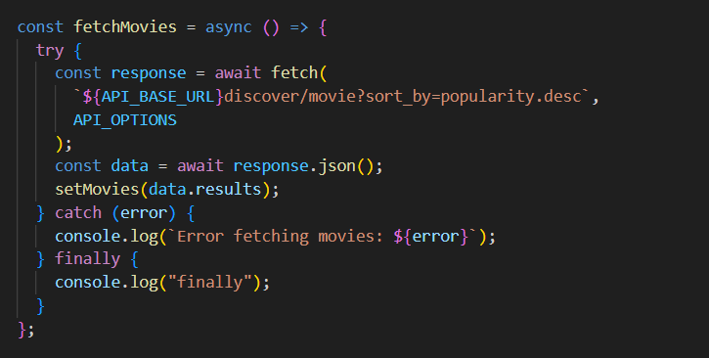
How to connect?
Get and sort the movies
Get the results from the json file!

Slide 15

03
MORE hooks
useReducer, useContext, useMemo

Slide 16
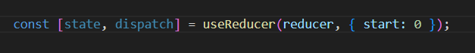
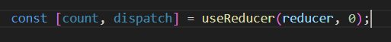
What is useReducer?
Managing Complex State with useReducerWhile useState is perfect for simple state (like a boolean toggle or a single string), your application's state can often become more complex. When you find yourself managing multiple related pieces of state that change together, useReducer can be a more powerful and organized alternative.
object
Normal initial like useState

Slide 17
Why and When to Use useReducer
You should consider using useReducer when:
You have complex state logic. If your state is an object or an array with multiple values that often change together, useReducer can make your code cleaner than managing many useState hooks.
The next state depends on the previous one. The reducer function receives the current state as an argument, making it easy to calculate the next state.
You want more predictable state transitions. All the logic for how your state can change is located in one place (the reducer function). This makes your state updates easier to understand, test, and debug.

Slide 18
How it Works: The Core Concepts
There are three core concepts to understand with useReducer:
State: The data your component is managing.
Action: A JavaScript object that describes what change should be made. By convention, actions have a type property (a string) and an optional payload (the data needed to make the change).Example: { type: 'INCREMENT', payload: 10 }
Reducer: A pure function that takes the current state and an action object as arguments and returns the new state. It's where all the update logic lives.
Syntax: (state, action) => newState
Dispatch: A special function that you call to send ("dispatch") an action to the reducer.

Slide 19
Example 1: A Simple Counter

Slide 20
What is useContext?
in React, data is typically passed down from parent to child components through props. This is called "prop drilling". While this works for simple applications, it can become cumbersome when you have many nested components and you need to pass data through several layers, even if some of the intermediate components don't use the data themselves.
The useContext hook provides a way to share data across your entire component tree without having to pass props down manually at every level. It allows you to create a "context" that holds data, and any component that needs that data can "subscribe" to it.

Slide 21
When and Why to Use useContext
You should consider using useContext when:
You have "global" data: This is data that many components in your app need to access, such as user authentication status, theme (e.g., light or dark mode), or in our case, a list of favorite movies.
You want to avoid prop drilling: As your application grows, passing props through many layers can make your code messy and difficult to maintain. useContext simplifies this by providing a more direct way to access data.
You want to manage state in a centralized location: By using context, you can manage the state of your application in one place, making it easier to reason about and debug.

Slide 22
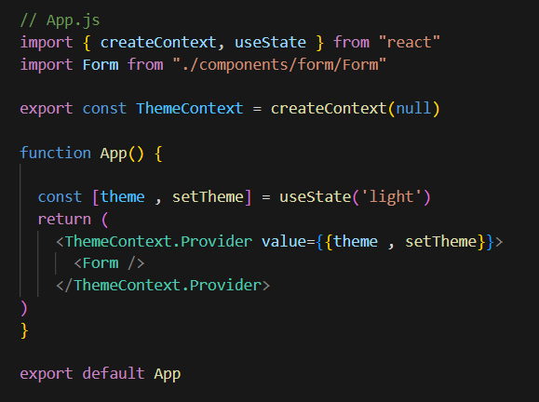
How to useContext
Create context: like making a menu
Provider: providing the menu so anyone can see it
useContext: the actual client seeing the menu
Creating
Provide
Click here to try demo

Slide 23
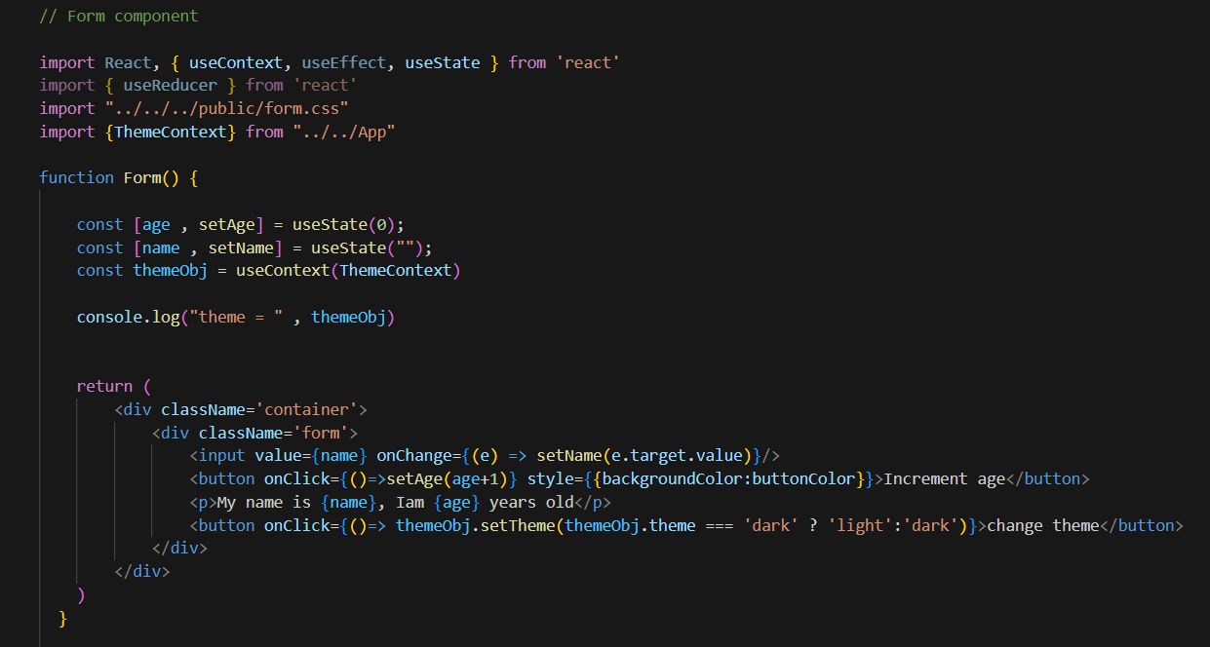
How to useContext
Not passing props
Using the context
Applying theme based on it

Slide 24
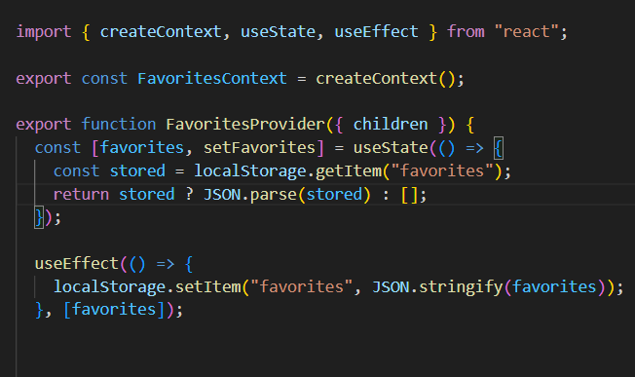
How to useContext
Create context: like making a menu
Provider: providing the menu so anyone can see it
useContext: the actual client seeing the menu
Creating
providing
applying

Slide 25
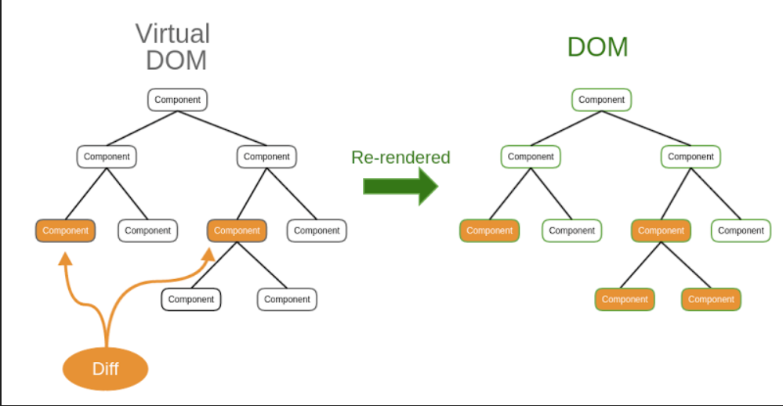
useMemo
Suppose components re-renders when state X changes
It will run all the JavaScript code in the component
What if we do some computation in the JS code that is not related to the state X?

Slide 26
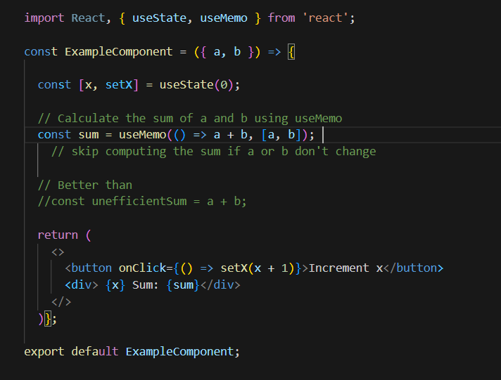
useMemo
Example:
React will only re-run the calculation function if a value in the dependency array (a or b) has changed since the last render. If the dependencies have not changed we will used the stored value from before

Slide 27

03
A custom hook?

Slide 28
What is a Custom Hook?
A custom hook is a JavaScript function whose name starts with "use" (e.g., useFetchMovies) that can call other hooks (like useState, useEffect, or even other custom hooks).
The primary purpose of a custom hook is to extract and reuse stateful logic from a component.
Think of it this way: if you find yourself writing the same useState and useEffect logic in multiple components, you can bundle that logic into a single custom hook and use it anywhere you need it.

Slide 29
Key Rules for Custom Hooks
Name must start with use. This is a mandatory convention that allows React to identify it as a hook and check for violations of the rules of hooks.
Only call hooks at the top level. Just like regular hooks, you cannot call them inside loops, conditions, or nested functions.
Example: Abstracting Data Fetching

Slide 30
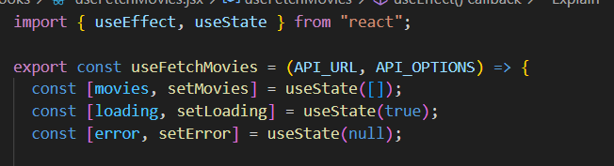
Example: Abstracting Data Fetching
To be more re-useable
Define all the states that will change

Slide 31
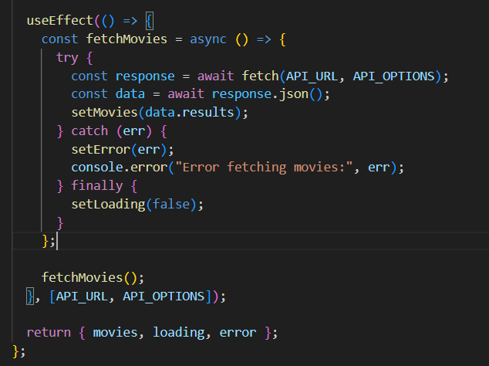
Example: Abstracting Data Fetching
The actual logic of the hook
Simply fetching from the provided parameters and getting the result to set the movies
Returning all the values to the component who called the hook

Slide 32
NPM packages
04

Slide 33

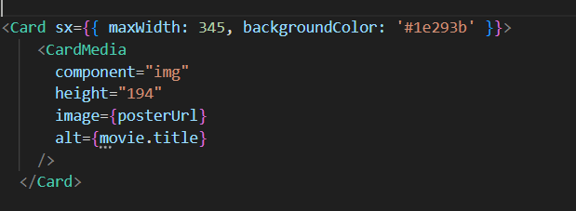
Material UI
Component Libraries (like Material-UI): Provide pre-built, accessible, and customizable UI components.
Click here: Material-UI templates

Slide 34
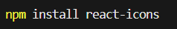

React Icons
What is it? React Icons is a fantastic library that bundles thousands of icons from many popular icon sets (like Font Awesome, Material Design, Ant Design, etc.) into a single package. It allows you to import any icon as a React component.
The import path follows a pattern: react-icons/<set_prefix>.
fa for Font Awesome
md for Material Design
fi for Feather Icons
...and many more!

Slide 35
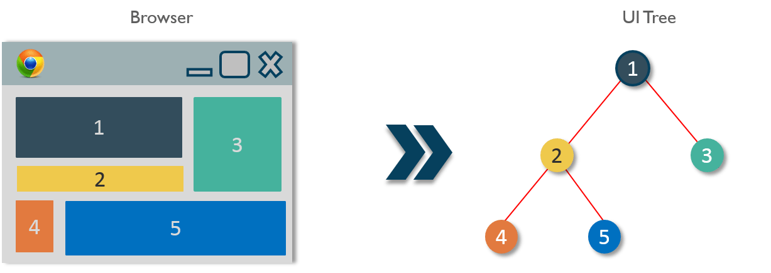
Components in react
React founders realized that everything on the web is in the form of components
So they got the idea of building interfaces from small pieces called Components

Slide 36
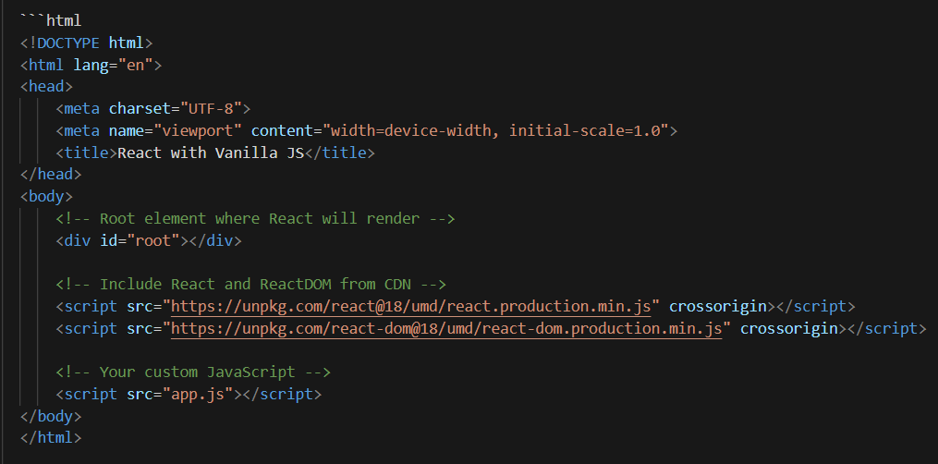
Example on using React as a library in JS
Warning: we never write React by this method, this is only for understanding purposes ):

Slide 37
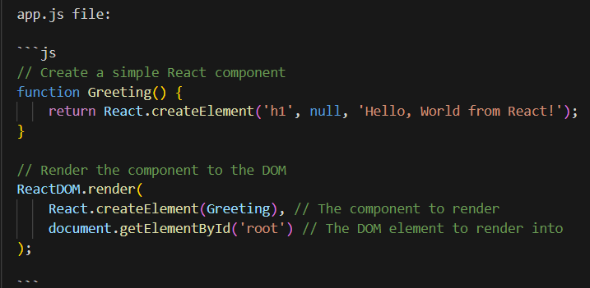
Example on using React as a library in JS
Warning: we never write React by this method, this is only for understanding purposes ):

Slide 38
Resources:
Why to use a framework?
Imperative vs Declarative programming styles
Imperative (vanilla js) vs Declarative (React)
VERY RECOMMENDED VIDEO: How react works?
RECOMMENDED READING: Why React re-renders?
Framework vs Library
React styling method
React documentation
Vite Documentation
Notes:
such as fetching data, manually manipulating the DOM, or setting up a subscription

